Slide 1
Bitcoin Network Analysis
CPSC 531 – Project
Tejaskumar Patel - CWID 885174433
Dhruv Dhorajiya - CWID 885177451

Slide 2
Overview
Bitcoin is digital currency with distributed ledger, where transactions are processed in multiple steps, i.e un-confirmed transaction of which resides in mempool temporarily and added to ledger after confirmations.
Distributed Network comprised of :
Nodes,
Stores and validates bitcoin transaction ledger.
There are 1000’s of nodes over the world,
Miners,
Higher Configurations machines responsible taking transaction from mempool, confirming, verifying, and adding to ledger after 6 confirmations.
Confirmation time depends on transaction size and miner capability

Slide 3
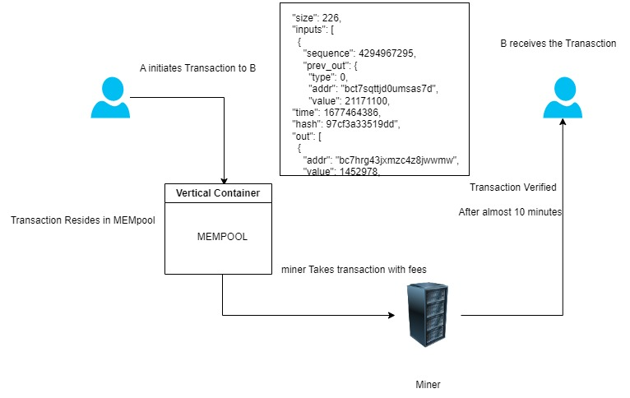
Cont..

Slide 4
So What?
Transactions are not instant.
Confirmation and addition of transaction to ledger takes different time, varying with transaction size and miner capability.
Hence, transaction in Mempool, before being placed in ledger, shall rise the possibility of :
Flooding of Mempool
Due to large size transactions taking more time for confirmations, incoming transactions are more, leading to
Network Congestion

Slide 5
What to analyze ?
Network Congestion Analysis
Transaction fees are paid by users to incentivize miners to include their transactions in the next block.
If the number of transactions is too high, and the transaction fees are too low, miners may not include the transaction in the next block they mine, resulting in delays in transaction confirmations i.e Network Congestion
When there are a large number of transactions waiting to be added to the blockchain, miners prioritize transactions based on the transaction fees that users are willing to pay.

Slide 6
How ?
Analyzing transaction fees
During times of network congestion, transaction fees tend to increase as users compete to have their transactions processed quickly.
By analyzing the trends in transaction fees, we can gain insights into the level of network congestion.
In sum, Higher fees ➔ Network Congestion state
For ex :
4 sat /bytes - Low Priority Transaction - Normal Health
6 sat /bytes - High Priority Transaction - Congestion Health

Slide 7
Technically ?
Getting the real-time un-confirmed transaction data, having relevant transactional details.
Data Source : https://www.blockchain.com/explorer/api/api_websocket
Processing, with large scale data processing and analytics engine
Data Structuring
Calculate Run-time volume and fees of total BTC
Visualization, categorize the fees within Bitcoin Network, while analyzing network congestion

Slide 8
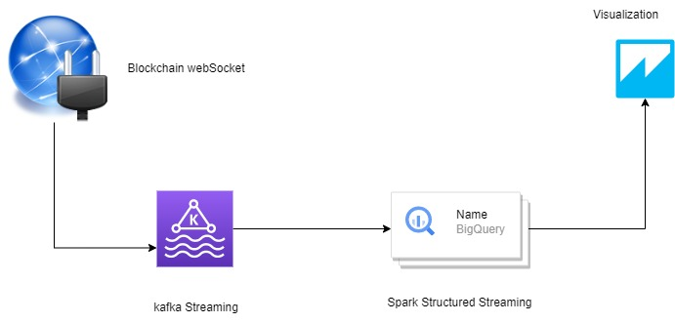
Flow

Slide 9
Tools And Techs
WebSocket IO
Retrieve real-time transaction data
Apache Kafka
Publish the data for processing
Apache Spark
Spark Structured Streaming
Streaming processing engine for real-time processing
Flask
Output sink for analysis

Slide 10
Thank You !

